Slide 1





Project
Oracle Digital Accounting:
Accounts Payable Module
Setup[EBS]

Slide 2


Prepared by
Ibrahim Abou Khalil

Slide 3
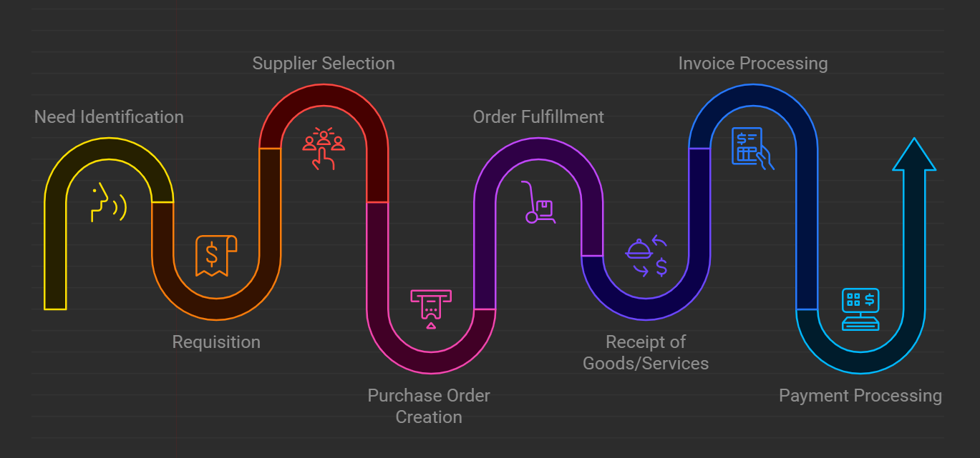

Procure to Pay Cycle (P2P)

Slide 4


1
OUR PROJECT
How You Implement Payables and Payments
The Invoicing and Payments Configuration for Rapid Implementation task list provides the framework for managing essential setups for Oracle Payables and Oracle Payments.
The framework includes setups for Oracle Procurement that are required for Payables. It also provides the setup steps for common options, distribution sets, and invoice tolerances for Payables, and the setup steps of disbursement system options, payment methods, and payment process profiles for Payments.

Slide 5

2
Account payable setup:
1. Accounting Financials Options Setup
2. Supplier- Purchasing Financials Options
3. Encumbrance Financials Options
4. VAT Registration Number
5. Human Resources Financials Options
6. Payable system setup
7. How to create suppliers
8. How to create supplier to used to process expense payments to internal employee

Slide 6
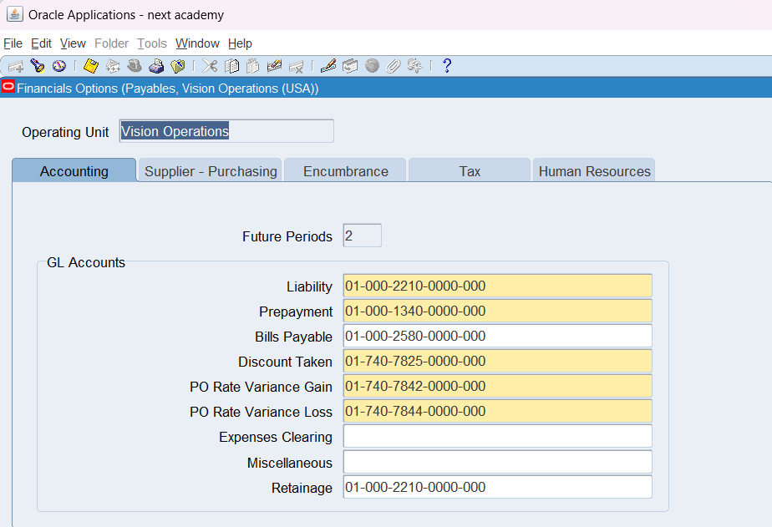
3
Accounting Financials Options Setup

Slide 7
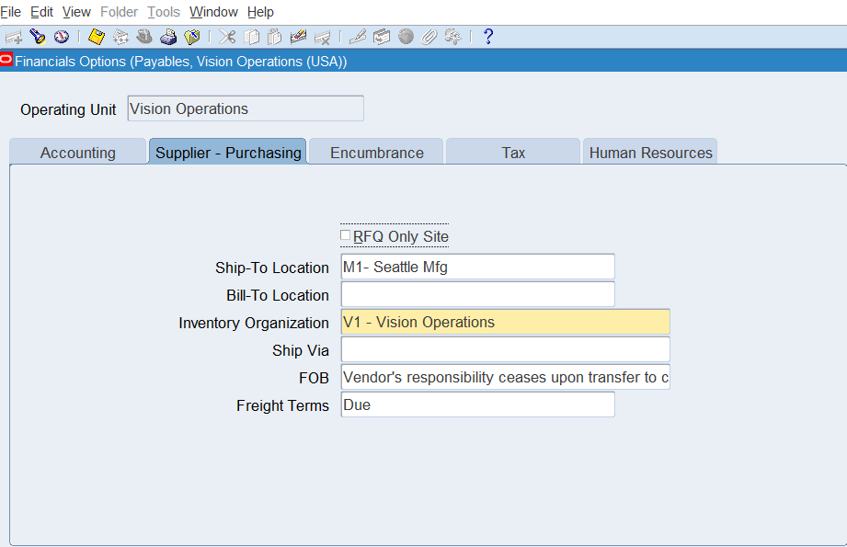
Supplier- Purchasing Financials Options
4

Slide 8
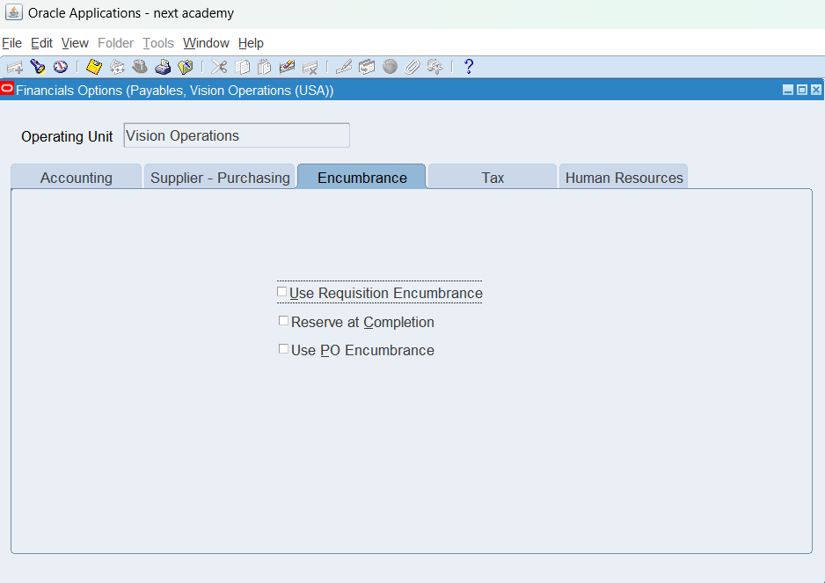
5
Encumbrance Financials Options

Slide 9
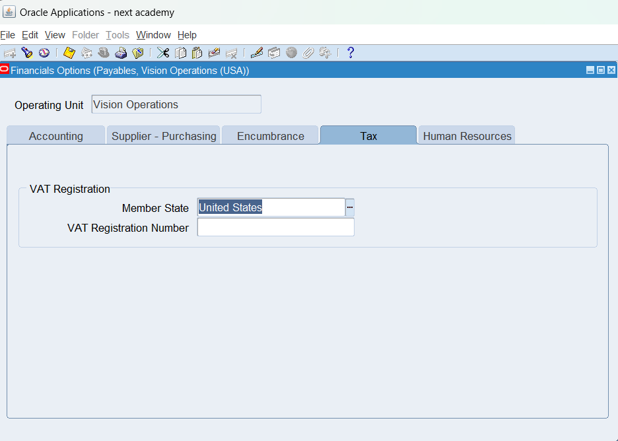
6
VAT Registration Number

Slide 10
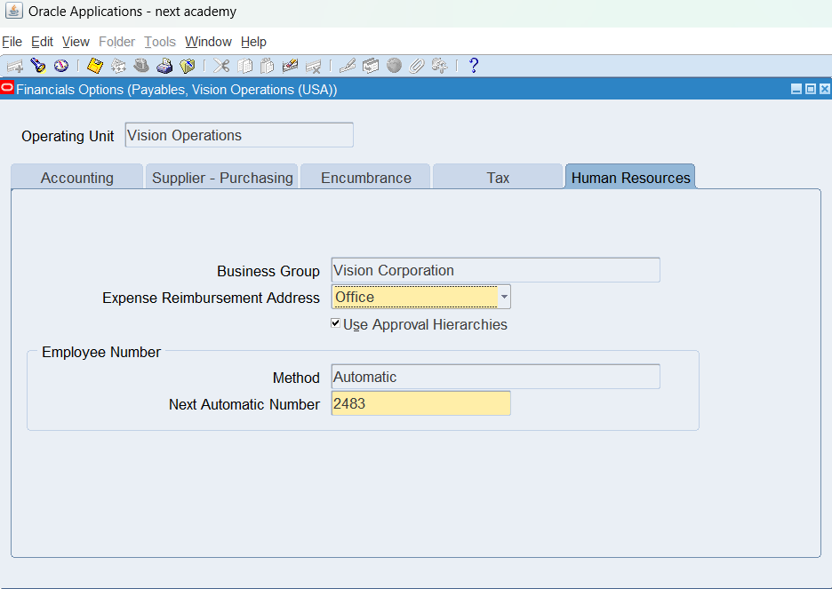
Human Resources Financials Options

Slide 11
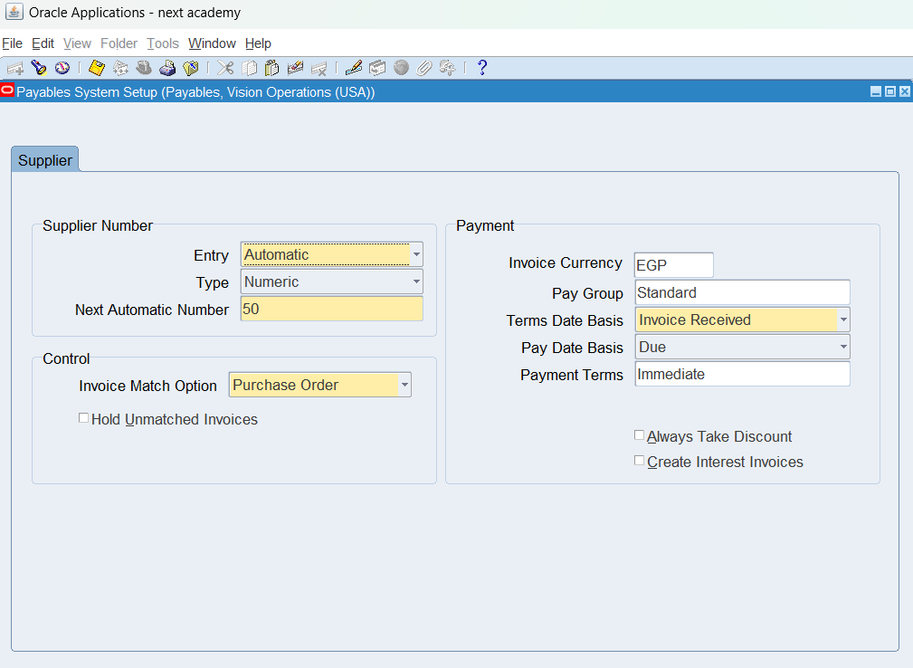
Payable system setup

Slide 12
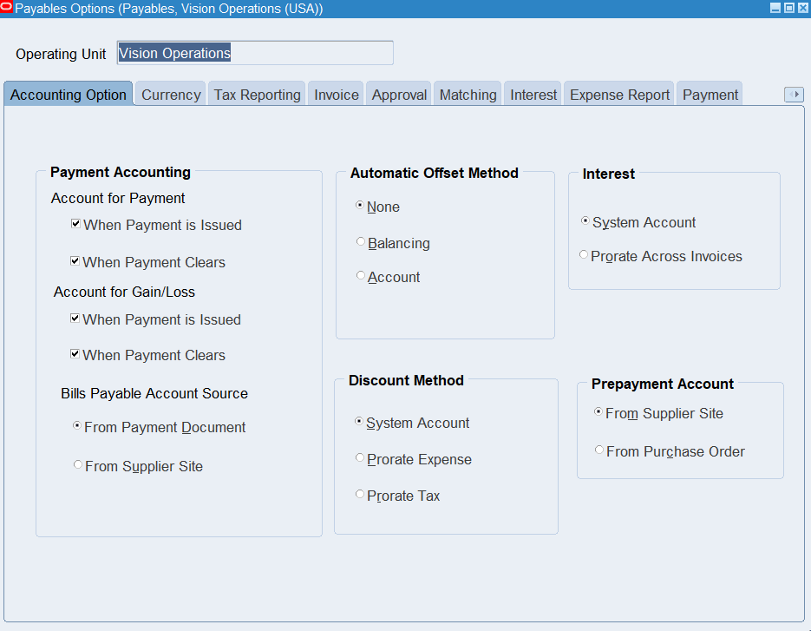
Payable options setup
Define Payment Terms:
Both (When Payment is Issued and When Payment Clears):
Payables accounts for each payment you issue twice-once as an unreconciled payment and once again as a cleared payment. If you select both options you have the same functionality as the Allow Reconciliation Accounting option provided in previous releases.

Slide 13
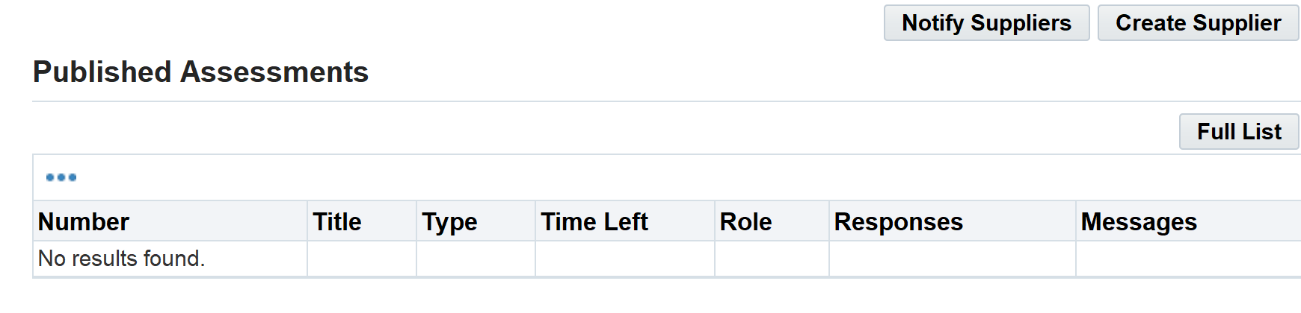
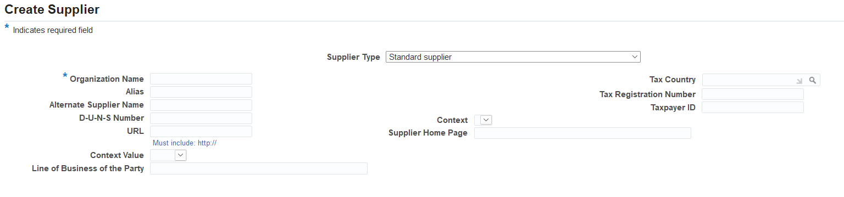
How to create suppliers

Slide 14
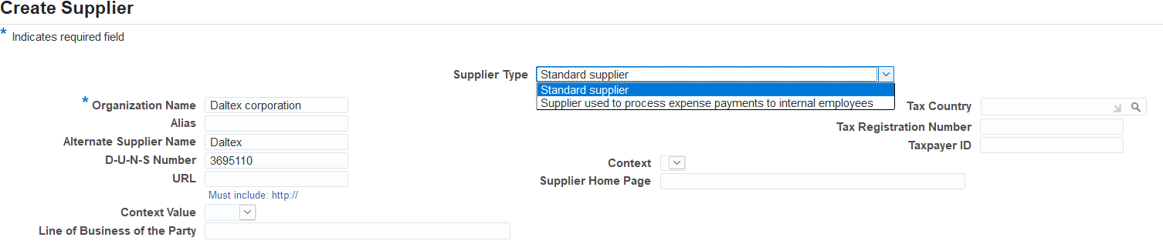
How to create supplier to used to process expense payments to internal employee

Slide 15
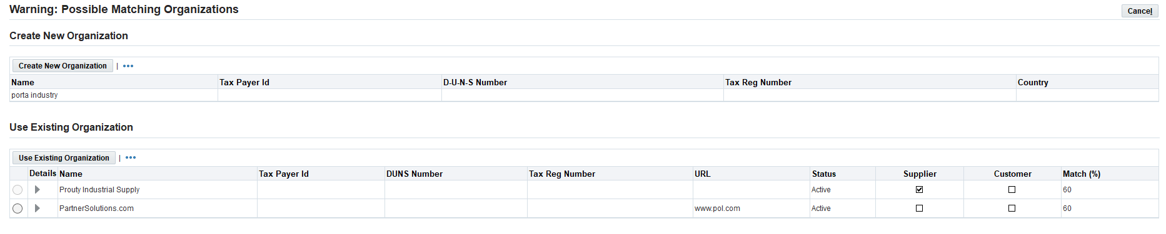
Click create new organization

Slide 16
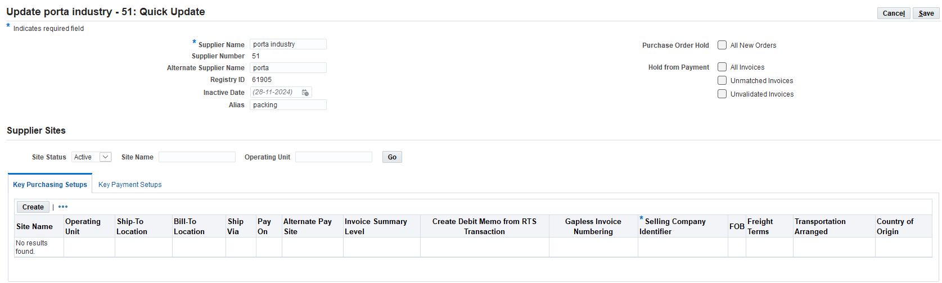
Fill in the mandatory fields

Slide 17
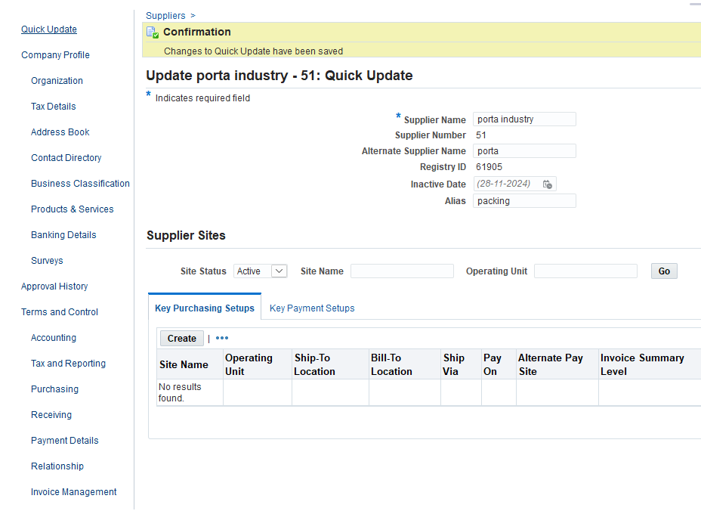
Click quick update

Slide 18
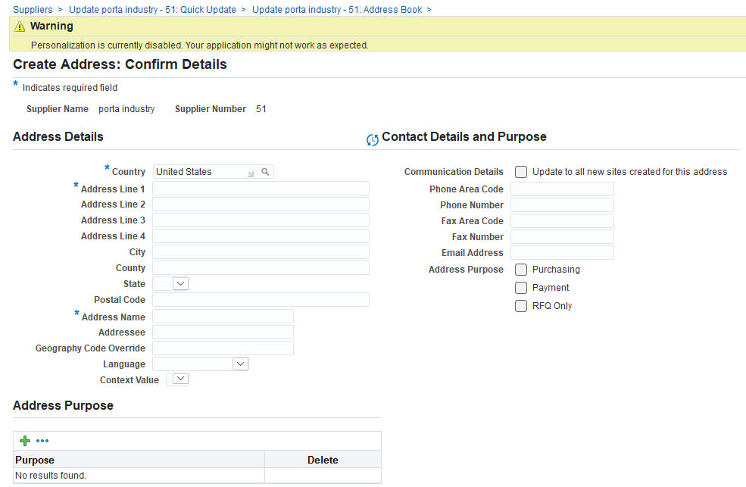
Fill in address details

Slide 19
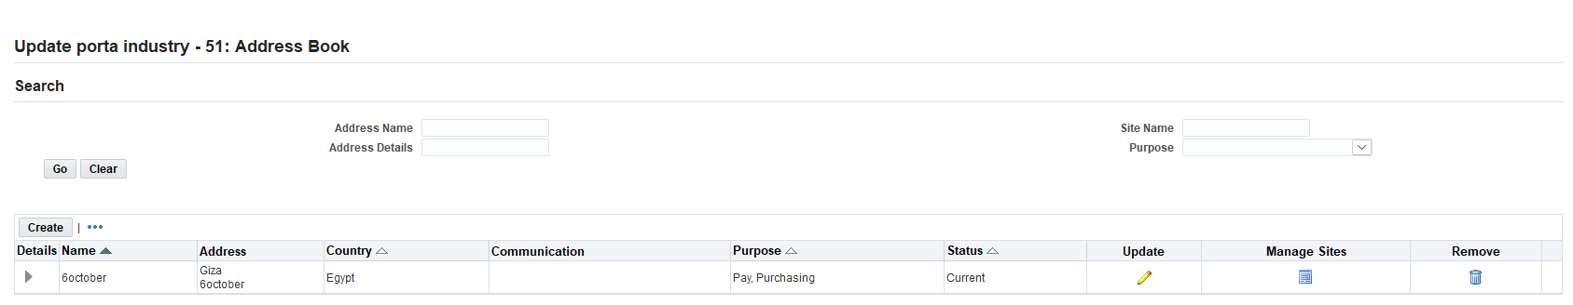
Click manage site

Slide 20
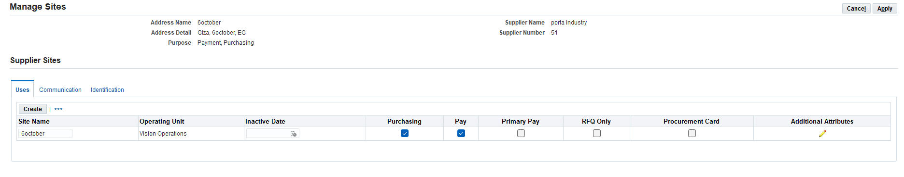
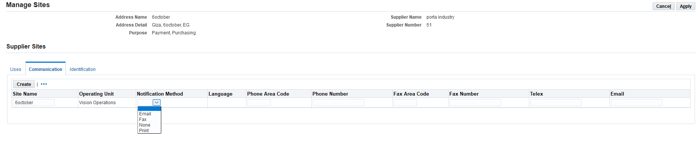
Select both options purchasing and pay
Selecting a button Communication

Slide 21
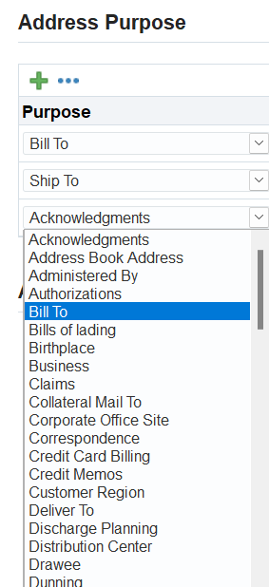
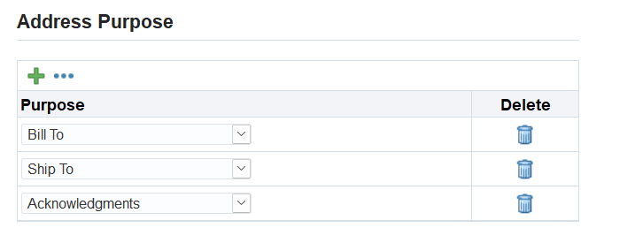
Selecting the Right Option

Slide 22
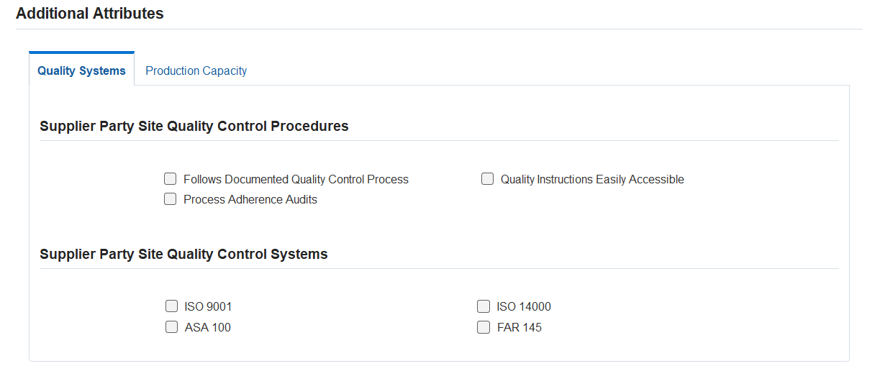
Supplier Party site Quality Control Procedure and System

Slide 23
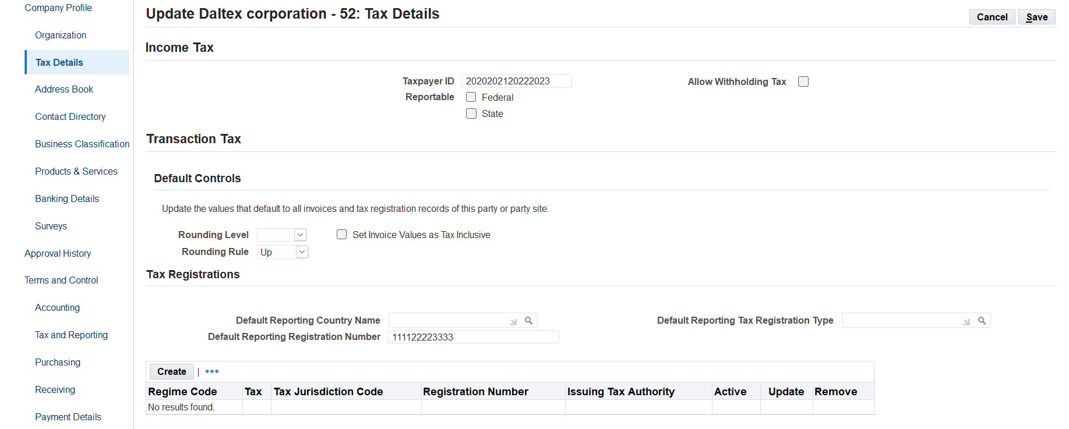
Definition of vendor tax settings

Slide 24
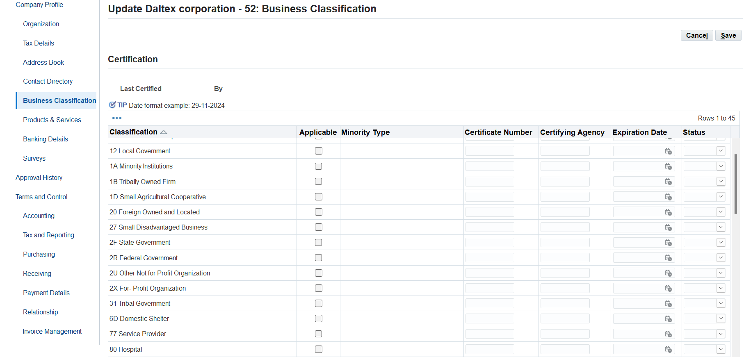
Determine the type of activity of the supplier

Slide 25
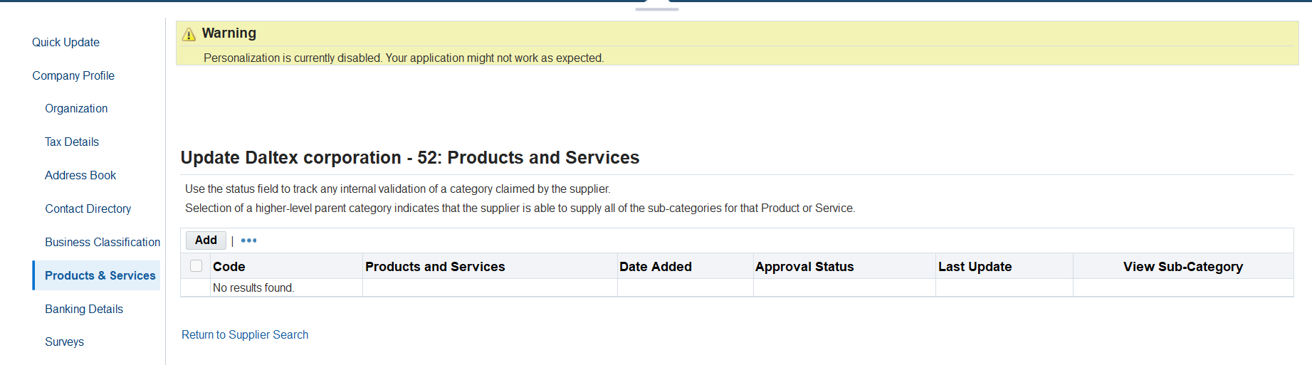
Determine the type of service for the product offered

Slide 26
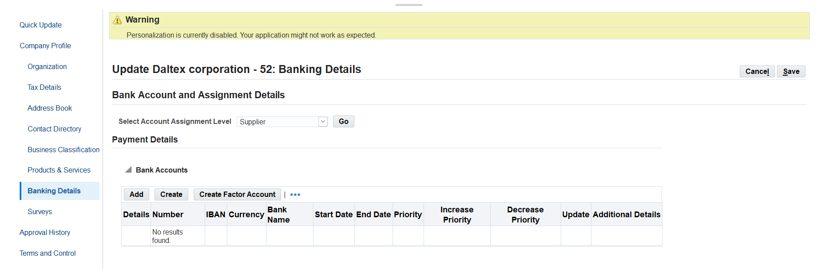
Fill in the details of the supplier's bank
CLICK Create Factor Account

Slide 27
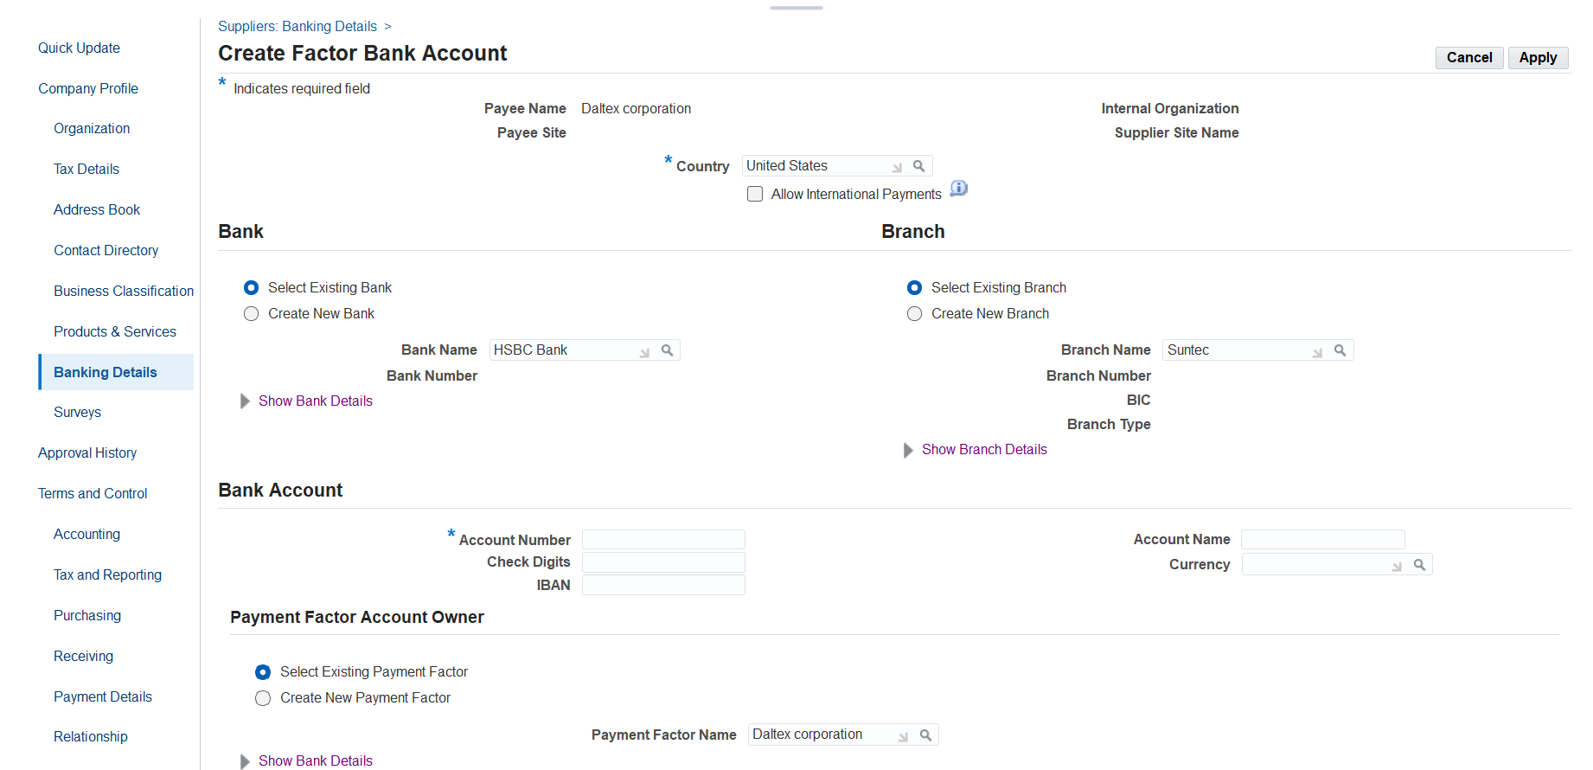

Slide 28
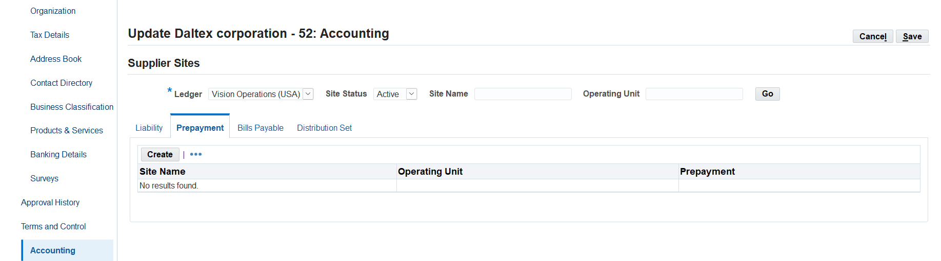
Definition of each of the following[Liability- prepayment-Bills payable-] accounts of the supplier
ر

Slide 29
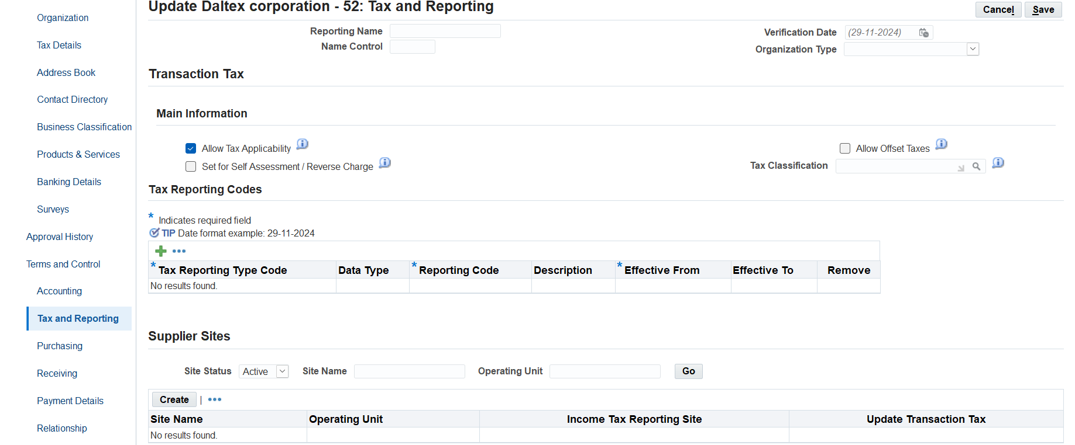
Vendor Tax Settings

Slide 30
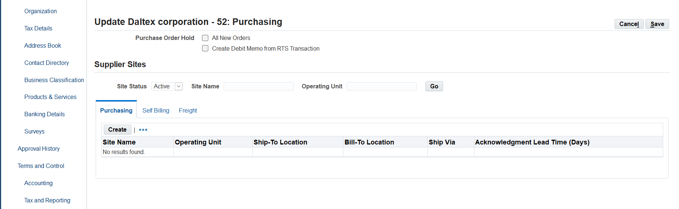
Define the terms of the shipping process
Determine where to ship the goods and send the invoice.

Slide 31
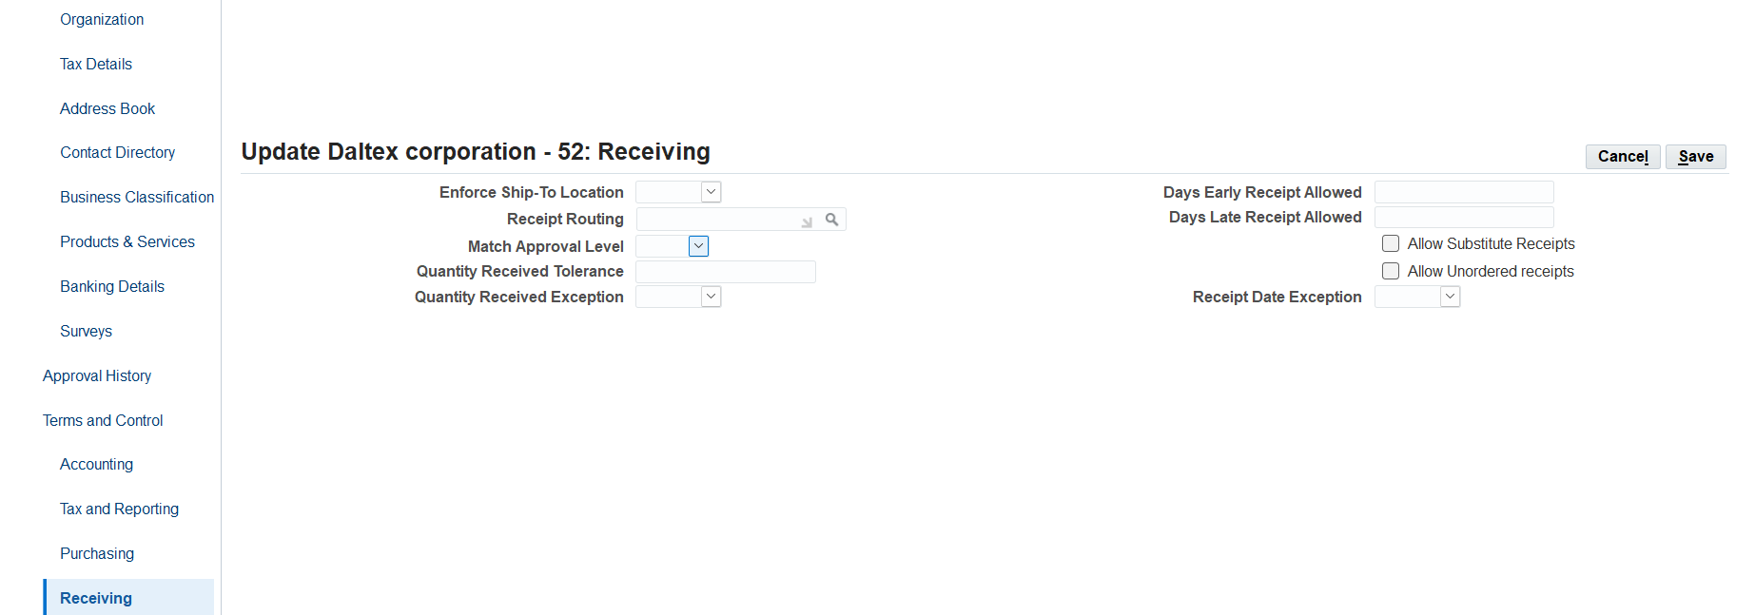
Terms of receipt and duration

Slide 32
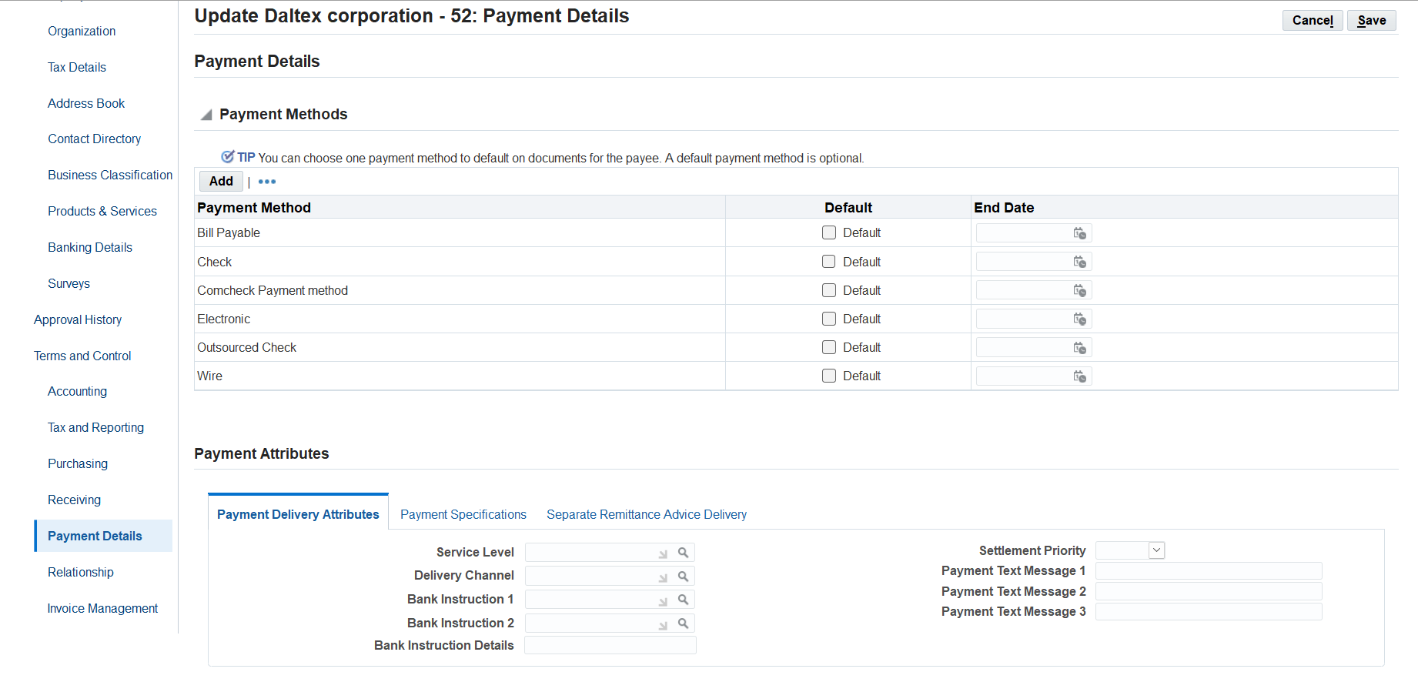
Optimization of payment methods

Slide 33
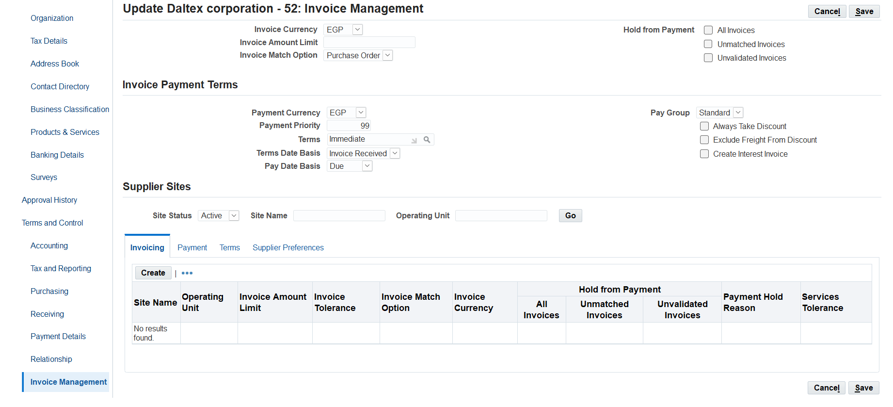
The process of managing invoices in terms of matching, payment terms and validation

Slide 34




OUR CONTACT
+0201093254471
ibrahimaboukhalil83edu@gmail.com
Giza_6 October_Zahraa New October

Slide 35

THANK YOU

